Slide 1
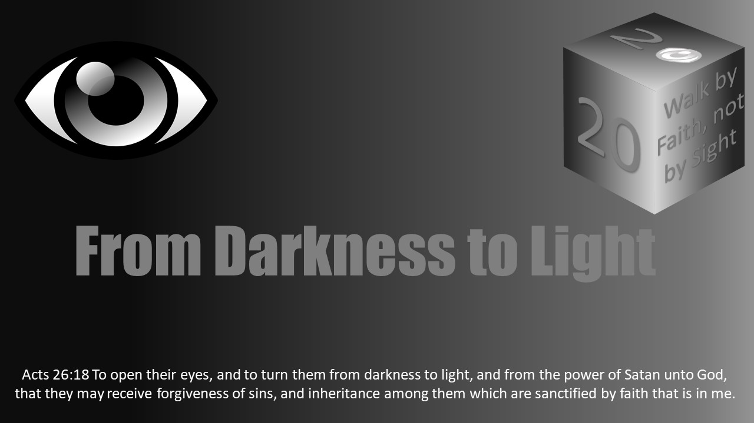


Slide 2
Light Lesson 24 Walking in the light Building a spiritually significant life

Slide 3
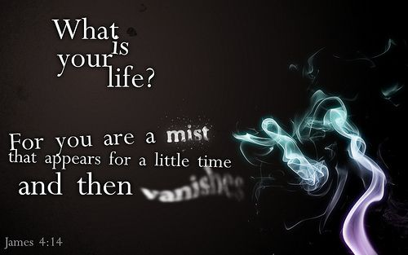
Introduction
“What is your life?”
James asked that question by inspiration (James 4:14).
His answer was: “It is even a vapor, that appeared for a little time, and then vanisheth away.”
This statement is a stark reality for us all, and it should affect the choices we make and the way we spend our sojourn here.

Slide 4
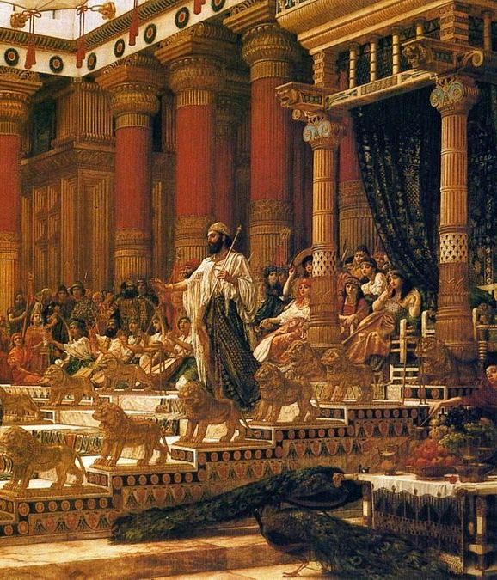
The Folly of Living for This World
Solomon was very possibly the richest man to ever live in history.
If we could equate his fortunes to modern equivalence, it’s likely he would make men such as Jeff Bezos, Bill Gates, or Warren Buffet look like relative paupers.
2 Chronicles 1:15 says that he “made silver and gold at Jerusalem as plenteous as stones.”
Imagine that! Precious metal as common as roadside gravel!
Yet for all his wealth, Solomon found his fortunes were “vexation” and “vanity.”

Slide 5
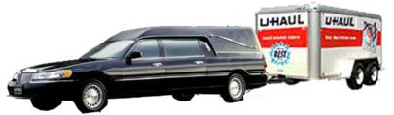

The Folly of Living for This World
One of Solomon’s great discouragements resulted from knowing he would leave all of his wealth behind.
“Yea, I hated all my labour which I had taken under the sun: because I should leave it unto the man that shall be after me. And who knoweth whether he shall be a wise man or a fool? yet shall he have rule over all my labour wherein I have laboured, and wherein I have shewed myself wise under the sun. This is also vanity.” (Eccl 2:18-19)
For all today who pursue money and the things it will buy, remember this: you will leave it all behind.
Paul said: “we brought nothing into this world, and it is certain we can carry nothing out” (1 Tim 6:7).

Slide 6
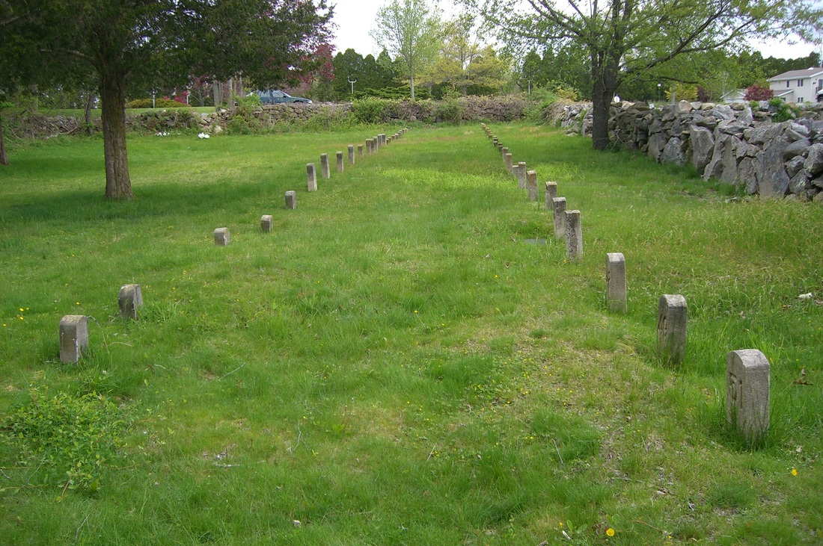
The Folly of Living for This World
Solomon was also vexed by the thought that he would die and be forgotten.
“For the living know that they shall die . . . neither have they any more a reward; for the memory of them is forgotten. Also their love, and their hatred, and their envy, is now perished; neither have they any more a portion for ever in any thing that is done under the sun.” (Eccl 9:5-6)

Slide 7
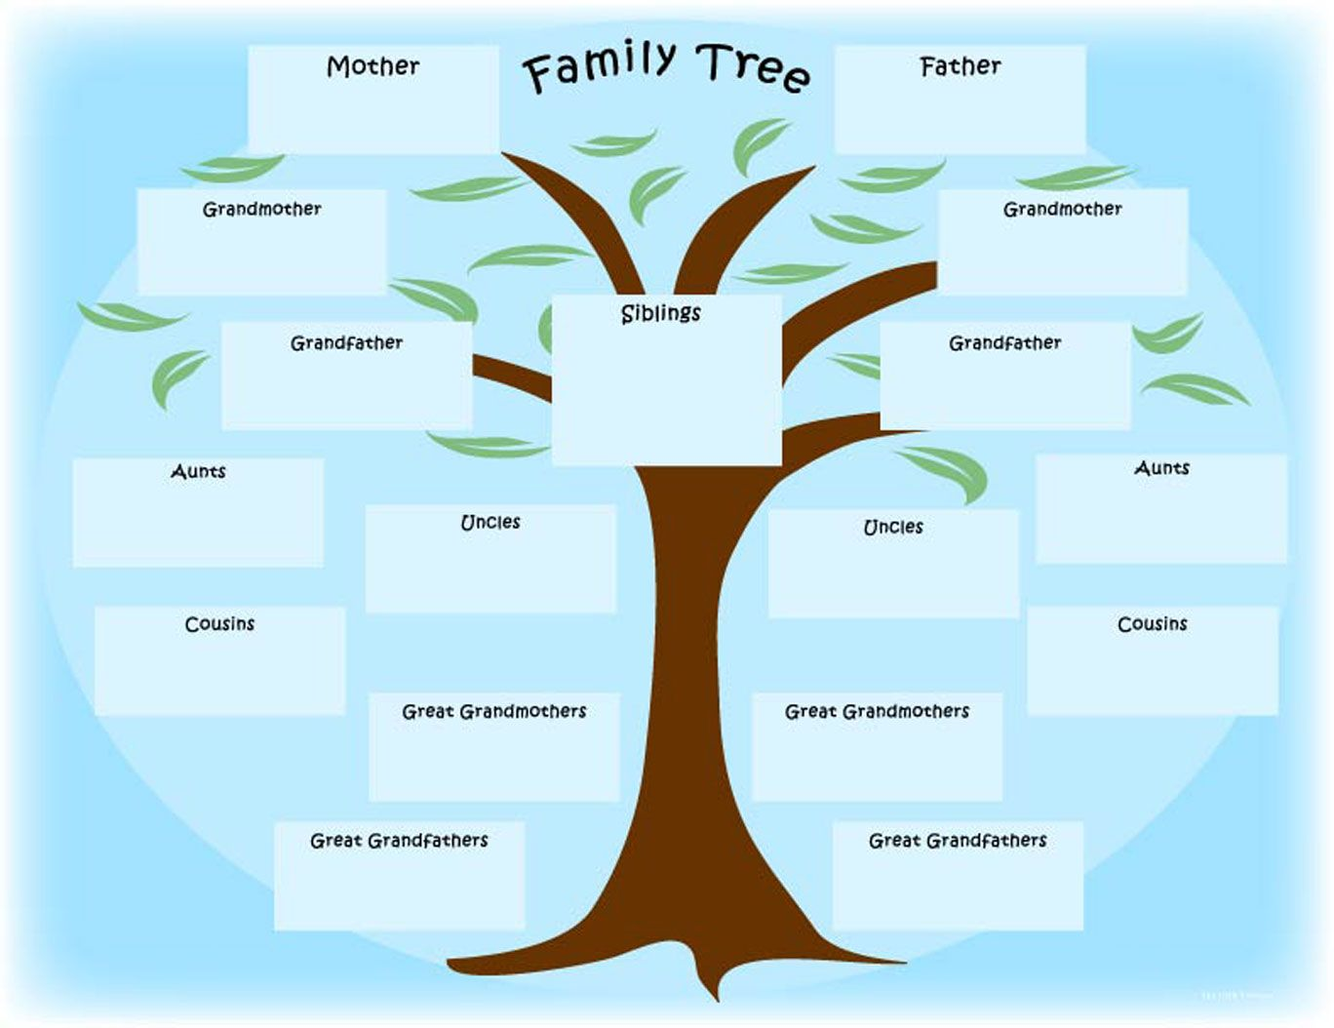
The Folly of Living for This World
If you think this won’t happen to you, try this simple exercise: without any research into the matter, write down the full names of your great-grandparents.
You have eight of them.
Do you even know their names?
Probably not, much less any knowledge of their lives and the things that were important to them.
Now, look forward.
There’s a high probability your grandchildren’s children won’t even know YOUR name!
You are going to die and be forgotten.
Therefore, it is completely illogical to place your top priorities on the passing things of this world.

Slide 8

Building a Spiritually Significant Life
To build a life with enduring significance, we clearly need to avoid materialism.
Jesus said: “Take heed, and beware of covetousness: for a man's life consisteth not in the abundance of the things which he possesseth.” (Luke 12:15)
To do otherwise is to open ourselves up to “many foolish and hurtful lusts, which drown men in destruction and perdition” (1 Tim 6:9).
Learn to be “content with what you have” (Heb 13:5).

Slide 9
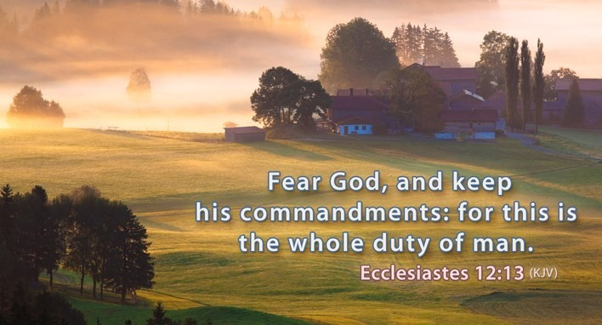
Building a Spiritually Significant Life
Solomon, as mentioned above, despite his wealth and success, was a truly vexed man.
However, in the final analysis, he got it right.
“Let us hear the conclusion of the whole matter: Fear God, and keep his commandments: for this is the whole duty of man.” (Eccl 12:13)
Surely, we need to do this.
Fearing God and humbly obeying His will is vital to the ‘spiritually significant life’ we want to live.

Slide 10

Building a Spiritually Significant Life
Of course, this eternally worthwhile life will require that we get our priorities in order.
“Seek ye first the kingdom of God, and his righteousness; and all these things shall be added unto you.” (Matt 6:33)
The things of this world are temporary, but the things of God will endure forever (1 John 2:15-17).
Since this is the case, our decisions should be made accordingly.

Slide 11

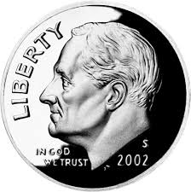
Building a Spiritually Significant Life
Try this test: offer a toddler a shiny coin in one hand and a crumbled-up bill in the other.
The child will go for the bright coin.
Sadly, we are often just as immature in prioritizing the temporal things of this world instead of the eternal values of Heaven.
All of this, of course, requires trusting God and His way rather than our own human wisdom or the philosophies of men.
“Trust in the Lord with all thine heart; and lean not unto thine own understanding. In all thy ways acknowledge him, and he shall direct thy paths.” (Prov 3:5-6)

Slide 12

Paul as an Example of a Spiritually Significant Life
Someone asked about the estate of a rich man who had recently died.
“How much did he leave behind?”
The answer was: “He left it all.”

Slide 13
Paul as an Example of a Spiritually Significant Life
What about Paul? What did he leave behind?
First, he apparently did not leave behind much material wealth.
Although he had “profited in the Jews’ religion above many my equals in mine own nation” (Gal 1:14), he gave that all up when he became a disciple of the Lord Jesus Christ.
“But what things were gain to me, those I counted loss for Christ. Yea doubtless, and I count all things but loss for the excellency of the knowledge of Christ Jesus my Lord: for whom I have suffered the loss of all things, and do count them but dung, that I may win Christ, and be found in him, not having mine own righteousness, which is of the law, but that which is through the faith of Christ, the righteousness which is of God by faith.” (Phil 3:7-9)

Slide 14
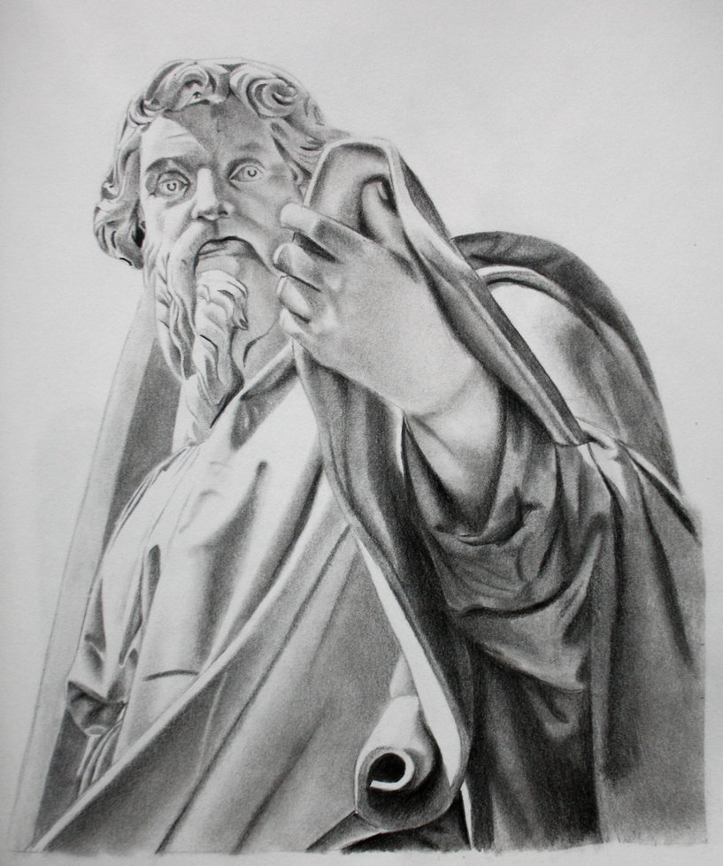
Paul as an Example of a Spiritually Significant Life
But, Paul did leave behind the worthy and enduring example of a life lived in dedicated service to the Lord.
He was always painfully mindful of his life before his conversion when he led the persecution against the early church (Acts 8:3, 1 Tim 1:12-16).
But, his turn around was so complete he could urge others to “be ye followers of me, even as I also am of Christ” (1 Cor 11:1).

Slide 15
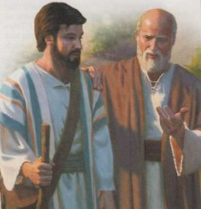
Paul as an Example of a Spiritually Significant Life
Paul’s legacy also included faithful brethren, converted and influenced by his life and teaching, who were there to carry the banner of Christ after he was gone.
He encouraged Timothy to do the same. “And the things that thou hast heard of me among many witnesses, the same commit thou to faithful men, who shall be able to teach others also.” (2 Tim 2:2)

Slide 16
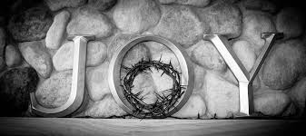
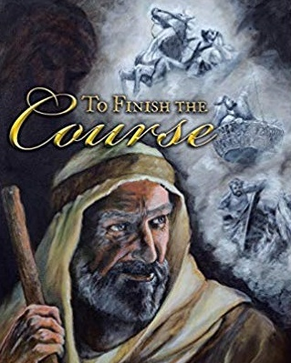
Paul as an Example of a Spiritually Significant Life
In the end, Paul could confidently say:
“For I am now ready to be offered, and the time of my departure is at hand. I have fought a good fight, I have finished my course, I have kept the faith: henceforth there is laid up for me a crown of righteousness, which the Lord, the righteous judge, shall give me at that day: and not to me only, but unto all them also that love his appearing.” (2 Tim 4:6-8)

Slide 17

What about us? Will our lives be spiritually significant?
The question boils down quite simply to this:
What will we leave behind?
What will we send ahead?
Things of this world will matter not at all in the end.
Only a life of faithful service and a reward in Heaven will matter. Paul said it this way:
“For our light affliction, which is but for a moment, worketh for us a far more exceeding and eternal weight of glory; while we look not at the things which are seen, but at the things which are not seen: for the things which are seen are temporal; but the things which are not seen are eternal.” (2 Cor 4:17-18)

